Slide 1
Chapter 7: Requirements Analysis
Chapter 8: Refining the Requirements Model
The Class Diagram (Relative stability of classes & instances) {7.4.1 Pg 168}
Analysis Class Stereotypes {7.3.2 Pg 165-167}
Attributes {7.4.2 Pg 168,169}
Adding and Locating Attributes {7.5.4 Pg 187}
Link and Association, Significance of Associations {7.4.4,7.4.5 Pg 170,171}
Adding Associations {7.5.6 Pg 189}
Generalization, Adding Further Structures {Pg 212, 8.3 Pg 214-220}
Composition, Composition in UML {Pg 213, 8.2.3 Pg 213,214}
Combining Generalization with Composition or Aggregation {8.3.2 Pg 220,221}
Multiplicity {7.4.7 Pg 172-174}
Determining Multiplicity {7.5.7 Pg 189}
Operations {7.4.8 Pg 174-176}
Finding Operations, Preliminary Allocation of Operations {7.5.8,7.5.9 Pg 190}
Other Approaches to finding Objects and Classes {7.5.3 Pg 183-187}
Assembling the Analysis Class Diagram {7.7, A3 Pg 194,200-207}
SohailIMRAN2@yahoo.com

Slide 2
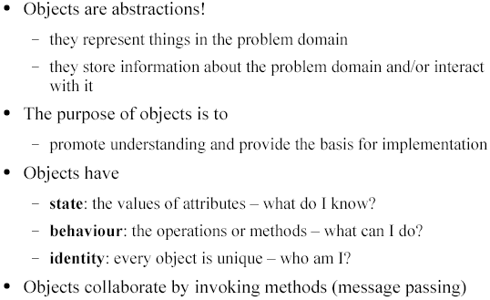
Objects
SohailIMRAN2@yahoo.com

Slide 3
Object Diagram
The notation for object diagrams (aka instance diagrams) is derived from class diagrams.
Object diagrams are used to show an instance of classes and their relationships at a point in time
Useful for illustrating complex behaviors and data structures
SohailIMRAN2@yahoo.com

Slide 4
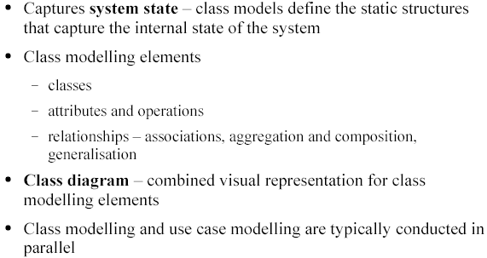
The Class Modelling
SohailIMRAN2@yahoo.com

Slide 5
Class Diagram
Models the static structural design view of a system
Typically used to express association, generalization (is-a) and aggregation (has-a) relationships between objects
SohailIMRAN2@yahoo.com

Slide 6
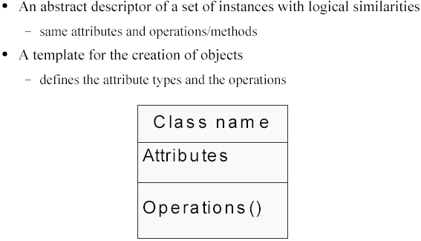
Classes
SohailIMRAN2@yahoo.com

Slide 7
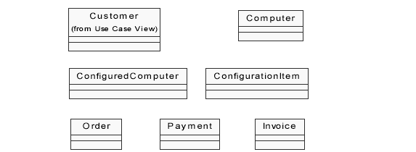
Classes - Example
SohailIMRAN2@yahoo.com

Slide 8
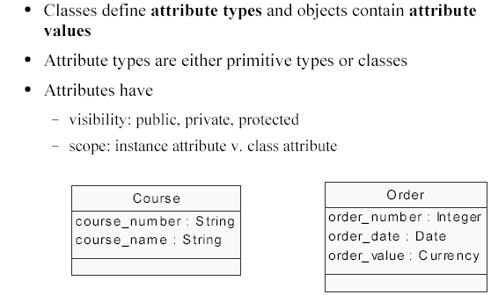
Attributes
SohailIMRAN2@yahoo.com

Slide 9
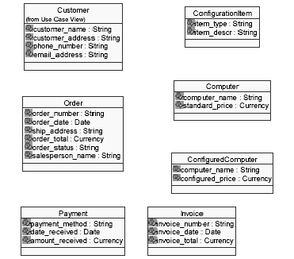
Classes and Attributes
SohailIMRAN2@yahoo.com

Slide 10
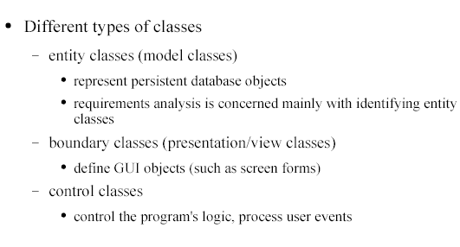
Types of Analysis Class Diagram
SohailIMRAN2@yahoo.com

Slide 11
Boundary class Stereotype
<<boundary>>
User Interface::AddAdvertUI
User Interface::withdrawUI
startInterface( )
startInterface( )
User Interface::withdrawUI
selectAccount( )
selectClient( )
getAmount( )
selectCampaign( )
SohailIMRAN2@yahoo.com

Slide 12
Entity class Stereotype
<<entity>>
Card
Card
CardNo
CardNo
PIN
PIN
status
status
Card
changePIN()
changePIN()
checkPIN( )
checkPIN( )
SohailIMRAN2@yahoo.com

Slide 13
Control class Stereotype
<<control>>
Control::withdrawCtrl
Control::withdrawCtrl
withdraw( )
withdraw( )
withdrawCtrl
SohailIMRAN2@yahoo.com

Slide 14
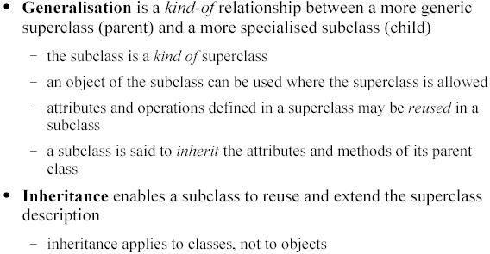
Inheritance, Generalization & Specialization
SohailIMRAN2@yahoo.com

Slide 15
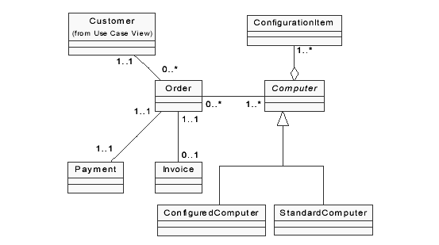
Generalization
SohailIMRAN2@yahoo.com

Slide 16
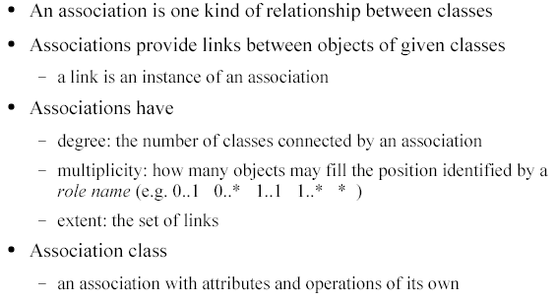
Associations
SohailIMRAN2@yahoo.com

Slide 17
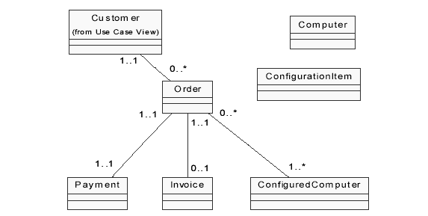
Associations
SohailIMRAN2@yahoo.com

Slide 18
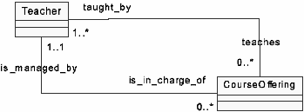
Association Multiplicity (Cardinality) Constrain
Constrain specifies the range of allowable objects that can be linked with an object of other class under that association (or on that role).
The format is, Lowerbound .. Upperbound
Role names - may be used with association at both ends or at one of the ends to increase clarity.
SohailIMRAN2@yahoo.com

Slide 19
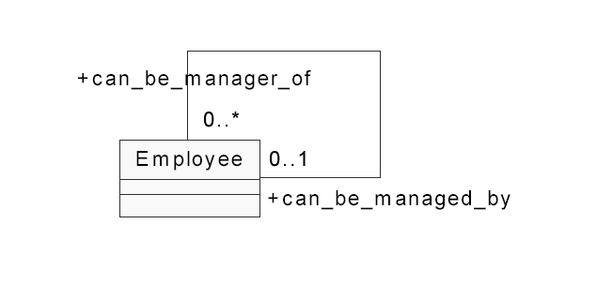
Association Degree (Unary Association)
SohailIMRAN2@yahoo.com

Slide 20
Other Constraints
Ordered
Holds must be in some
order
1
placeOn
0..*
book
hold
{ordered}
1
employee
Subset
Manager must be an
employee
*
company
{subset}
person
1
manager
*
XOR
Prevents artificial
subclasses
*
perOwner
account
Person
*
{exclusive or}
Account
1
orgOwner
account
Organisa
*
SohailIMRAN2@yahoo.com

Slide 21
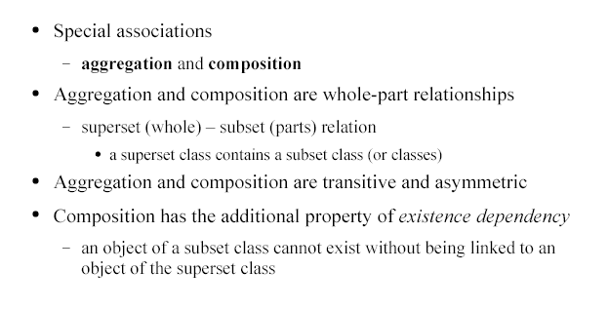
Aggregation and Composition
SohailIMRAN2@yahoo.com

Slide 22
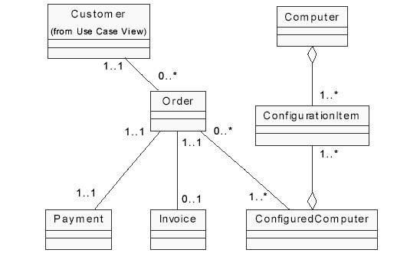
Aggregation
SohailIMRAN2@yahoo.com

Slide 23
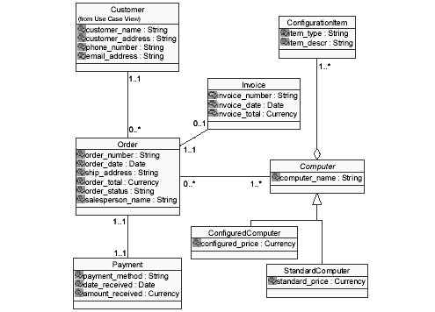
Class Diagram
SohailIMRAN2@yahoo.com

Slide 24
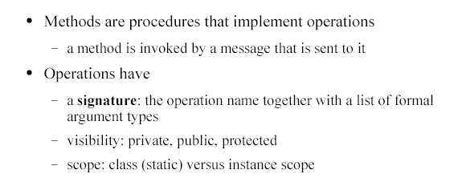
Class Operations
SohailIMRAN2@yahoo.com

Slide 25
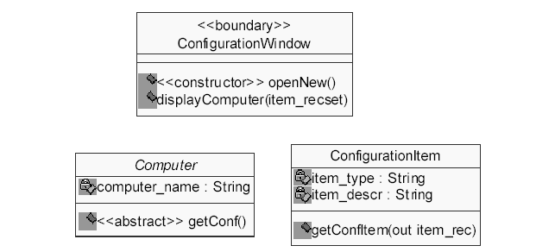
Class Operations
SohailIMRAN2@yahoo.com

Slide 26
Visibility (of class members)
Visibility affects the accessibility of a class member outside its boundary
If a member is to be used in any of its subclasses directly, define it as ‘Protected’.
Account
3 types
Public (+)
Protected (#)
Private (-).
- nextAno
- aNo
# balance
+ balance( )
+ withdraw( )
SohailIMRAN2@yahoo.com

Slide 27
Binding
The process of determining which process to be invoked for a certain message call
  Static binding → Determined at compile time
  Dynamic binding → Determined later at run time
Dynamic binding gives flexibility.
Allows the invocation decision to be postponed until additional information is known.
SohailIMRAN2@yahoo.com

